Slide 1
Graphs- DFS & BFS
3rd Grade
College of Computer Science and Information Technology
Department of Computer Science
Data Structures
Lecture 7
Instructor: Ghazwan Abdulnabi Al-Ali
University of Basrah, Iraq

Slide 2
DEPTH-FIRST SEARCH
The depth-first search uses a stack to remember where it should go when it reaches a dead end.
To carry out the depth-first search, you pick a starting point—in this case, vertex A. You then do three things: visit this vertex, push it onto a stack so you can remember it, and mark it so you won’t visit it again.
Next you go to any vertex adjacent to A that hasn’t yet been visited. We’ll assume the vertices are selected in alphabetical order, so that brings up B. You visit B, mark it, and push it on the stack.
Now what? You’re at B, and you do the same thing as before: go to an adjacent vertex that hasn’t been visited. This leads you to F. We can call this process Rule 1.

Slide 3
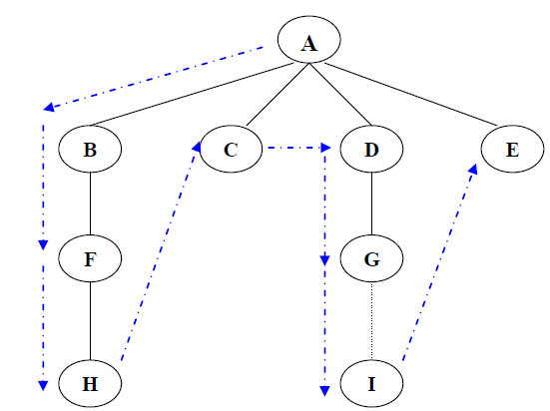
Remember: Rules
Remember:
Rule 1: If possible, visit an adjacent unvisited vertex, mark it, and push it on the stack.
Apply rule 1 until we reach a dead end (no unvisited vertices adjacent). Apply rule 2.
Rule 2: If you can’t follow Rule 1, then, if possible, pop a vertex off the stack.

Slide 4
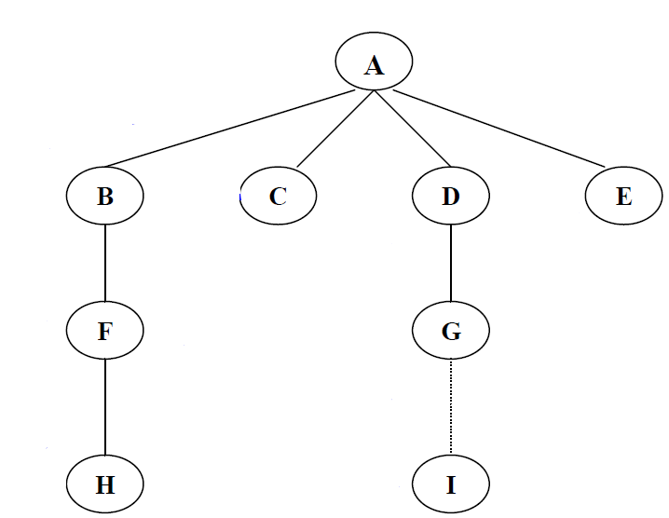
EX-1
Stack | Stack
Visit A | A

Slide 5
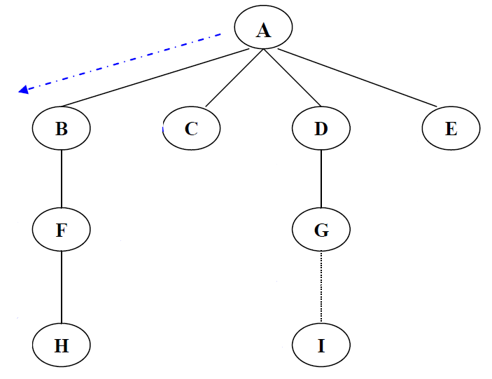
EX-1 Cont..
Stack | Stack
Visit A | A
Visit B | A,B

Slide 6
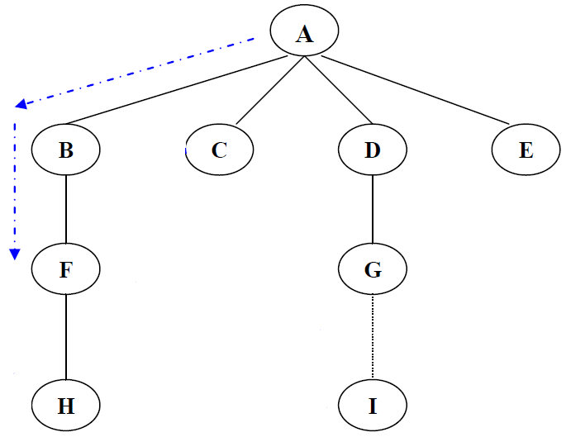
EX-1 Cont..
Stack | Stack
Visit A | A
Visit B | A,B
Visit F | A,B,F

Slide 7
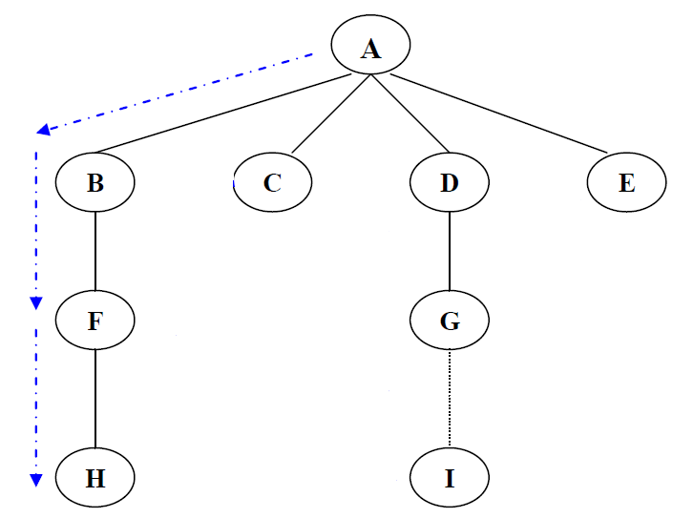
EX-1 Cont..
Stack | Stack
Visit A | A
Visit B | A,B
Visit F | A,B,F
Visit H | A,B,F,H
If you can’t follow Rule 1, then, if possible, pop a vertex off the stack.

Slide 8
EX-1 Cont..
Stack | Stack
Visit A | A
Visit B | A,B
Visit F | A,B,F
Visit H | A,B,F,H
Pop H | A,B,F
If you can’t follow Rule 1, then, if possible, pop a vertex off the stack.

Slide 9
EX-1 Cont..
Stack | Stack
Visit A | A
Visit B | A,B
Visit F | A,B,F
Visit H | A,B,F,H
Pop H | A,B,F
Pop F | A,B
If you can’t follow Rule 1, then, if possible, pop a vertex off the stack.

Slide 10
EX-1 Cont..
Stack | Stack
Visit A | A
Visit B | A,B
Visit F | A,B,F
Visit H | A,B,F,H
Pop H | A,B,F
Pop F | A,B
Pop B | A
If possible, visit an adjacent unvisited vertex, mark it, and push it on the stack.

Slide 11
EX-1 Cont..
Stack | Stack
Visit A | A
Visit B | A,B
Visit F | A,B,F
Visit H | A,B,F,H
Pop H | A,B,F
Pop F | A,B
Pop B | A
Visit C | A,C
If you can’t follow Rule 1, then, if possible, pop a vertex off the stack.

Slide 12
EX-1 Cont..
Stack | Stack
Visit A | A
Visit B | A,B
Visit F | A,B,F
Visit H | A,B,F,H
Pop H | A,B,F
Pop F | A,B
Pop B | A
Visit C | A,C
Pop C | A
If you can’t follow Rule 1, then, if possible, pop a vertex off the stack.

Slide 13
EX-1 Cont..
Stack | Stack
Visit A | A
Visit B | A,B
Visit F | A,B,F
Visit H | A,B,F,H
Pop H | A,B,F
Pop F | A,B
Pop B | A
Visit C | A,C
Pop C | A
Visit D | A,D
Visit G | A,D,G
Visit I | A,D,G.I

Slide 14
EX-1 Cont..
Stack | Stack
Visit A | A
Visit B | A,B
Visit F | A,B,F
Visit H | A,B,F,H
Pop H | A,B,F
Pop F | A,B
Pop B | A
Visit C | A,C
Pop C | A
Visit D | A,D
Visit G | A,D,G
Visit I | A,D,G,I

Slide 15
EX-1 Cont..
Stack | Stack
Visit A | A
Visit B | A,B
Visit F | A,B,F
Visit H | A,B,F,H
Pop H | A,B,F
Pop F | A,B
Pop B | A
Visit C | A,C
Pop C | A
Visit D | A,D
Visit G | A,D,G
Visit I | A,D,G,I
Pop I | A,D,G
Pop G | A,D
Pop G | A

Slide 16
EX-1
Stack | Stack
Visit A | A
Visit B | A,B
Visit F | A,B,F
Visit H | A,B,F,H
Pop H | A,B,F
Pop F | A,B
Pop B | A
Visit C | A,C
Pop C | A
Visit D | A,D
Visit G | A,D,G
Visit I | A,D,G,I
Pop I | A,D,G
Pop G | A,D
Pop G | A
Visit E | A,E
Pop E | A
Pop A | Empty

Slide 17
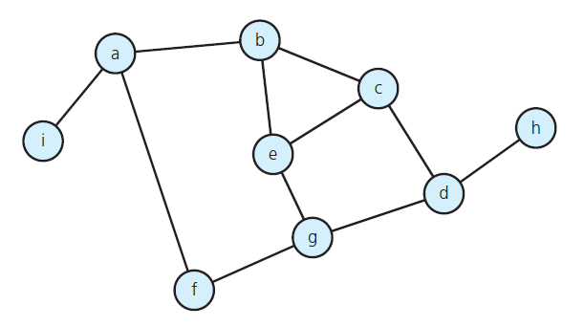
EX-2

Slide 18
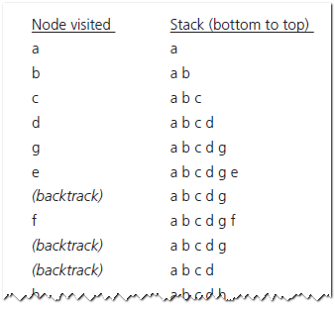
EX-2 Cont..

Slide 19
EX-2 Cont..
visit

Slide 20
EX-2 Cont..
visit

Slide 21
EX-2 Cont..
visit

Slide 22
EX-2 Cont..
visit

Slide 23
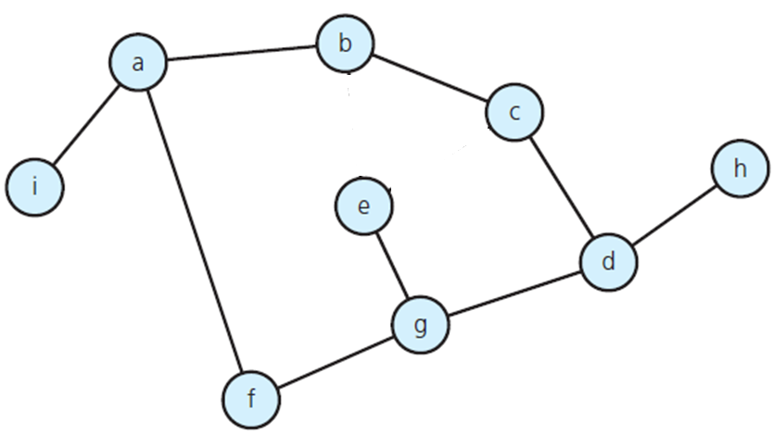
EX-2 Cont..
visit already visited

Slide 24
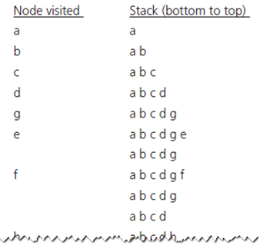
EX-2 Cont..
Pop e
Backtrack(Pop) visit already visited

Slide 25
EX-2 Cont..
Pop e

Slide 26
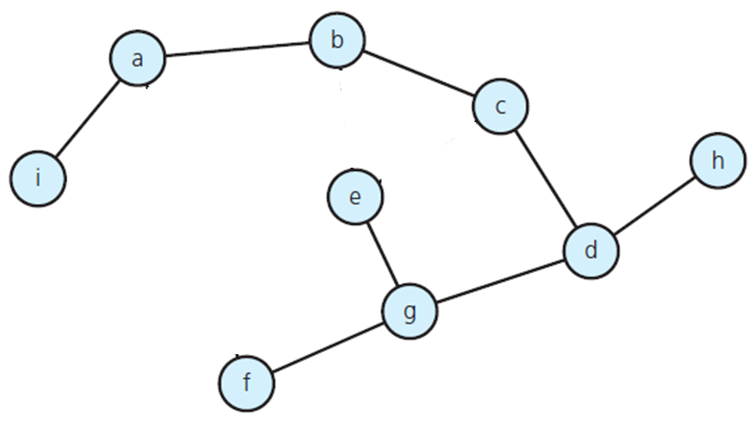
EX-2 Cont..
Pop e
Backtrack(Pop) visit already visited

Slide 27
EX-2 Cont..
Pop e
Pop F
Backtrack(Pop) visit already visited

Slide 28
EX-2 Cont..
Pop e
Pop F
Pop G
Backtrack(Pop) visit already visited

Slide 29
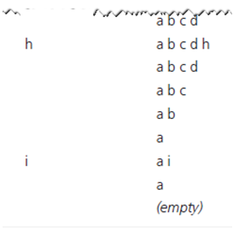
EX-2 Cont..
Pop d
Pop c
Pop b
Pop i
Pop a
Backtrack(Pop) visit already visited

Slide 30
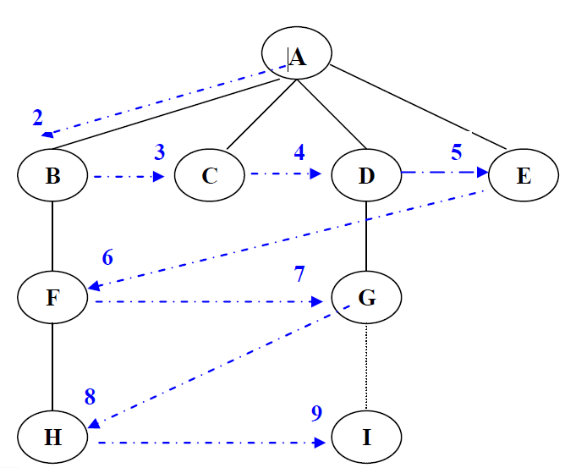
BREADTH-FIRST SEARCH
the algorithm likes to stay as close as possible to the starting point.
It visits all the vertices adjacent to the starting vertex, and only then goes further afield. This kind of search is implemented using a queue instead of a stack.

Slide 31
Remember: Rules
Rule 1: Visit the next unvisited vertex (if there is one) that’s adjacent to the current vertex, mark it, and insert it into the queue.
Rule 2: If you can’t carry out Rule 1 because there are no more unvisited vertices, remove a vertex from the queue (if possible) and make it the current vertex.
Rule 3: If you can’t carry out Rule 2 because the queue is empty, you’re finished.

Slide 32
EX-1
-
A
B
C
D
E
F
G
H
I
enqueue source node
front
A
FIFO Queue

Slide 33
EX-1 Cont..
-
A
B
C
D
E
F
G
H
I
dequeue next vertex A
front
FIFO Queue

Slide 34
EX-1 Cont..
-
A
B
C
D
E
F
G
H
I
B discovered
front
B
FIFO Queue

Slide 35
EX-1 Cont..
-
A
B
C
D
E
F
G
H
I
I discovered
front
B,I
FIFO Queue

Slide 36
EX-1 Cont..
-
A
B
C
D
E
F
G
H
I
Finished with A
front
B,I
FIFO Queue

Slide 37
EX-1 Cont..
-
A
B
C
D
E
F
G
H
I
dequeue next vertex B
front
I,F
FIFO Queue

Slide 38
EX-1 Cont..
-
A
B
C
D
E
F
G
H
I
A already discovered
front
I,F
FIFO Queue

Slide 39
EX-1 Cont..
-
A
B
C
D
E
F
G
H
I
visit neighbors of I
front
F
FIFO Queue

Slide 40
EX-1 Cont..
-
A
B
C
D
E
F
G
H
I
dequeue next vertex I
front
F,E
FIFO Queue

Slide 41
EX-1 Cont..
-
A
B
C
D
E
F
G
H
I
I finished
front
F,E
FIFO Queue

Slide 42
EX-1 Cont..
-
A
B
C
D
E
F
G
H
I
dequeue next vertex F
front
E
FIFO Queue

Slide 43
EX-1 Cont..
-
A
B
C
D
E
F
G
H
I
G discovered
front
E,G
FIFO Queue

Slide 44
EX-1 Cont..
-
A
B
C
D
E
F
G
H
I
F finished
front
E,G
FIFO Queue

Slide 45
EX-1 Cont..
-
A
B
C
D
E
F
G
H
I
dequeue next vertex E
front
G
FIFO Queue

Slide 46
EX-1 Cont..
-
A
B
C
D
E
F
G
H
I
dequeue next vertex G
front
FIFO Queue

Slide 47
EX-1 Cont..
-
A
B
C
D
E
F
G
H
I
C discovered
front
C
FIFO Queue

Slide 48
EX-1 Cont..
-
A
B
C
D
E
F
G
H
I
H discovered
front
C,H
FIFO Queue

Slide 49
EX-1 Cont..
-
A
B
C
D
E
F
G
H
I
G finished
front
C,H
FIFO Queue

Slide 50
EX-1 Cont..
-
A
B
C
D
E
F
G
H
I
dequeue next vertex C
front
H
FIFO Queue

Slide 51
EX-1 Cont..
-
A
B
C
D
E
F
G
H
I
D discovered
front
H,D
FIFO Queue

Slide 52
EX-1 Cont..
-
A
B
C
D
E
F
G
H
I
C finished
front
H,D
FIFO Queue

Slide 53
EX-1 Cont..
-
A
B
C
D
E
F
G
H
I
dequeue next vertex H
front
D
FIFO Queue

Slide 54
EX-1 Cont..
-
A
B
C
D
E
F
G
H
I
H finished
front
D
FIFO Queue

Slide 55
EX-1 Cont..
-
A
B
C
D
E
F
G
H
I
dequeue next vertex D
front
FIFO Queue

Slide 56
EX-1 Cont..
-
A
B
C
D
E
F
G
H
I
D finished
front
FIFO Queue

Slide 57
Thank You

